Slide 1
Medicare Opportunities Presentation
Summer Long, Elise Katsnelson, Beatrice Katsnelson, Maria Tamayo

Slide 2
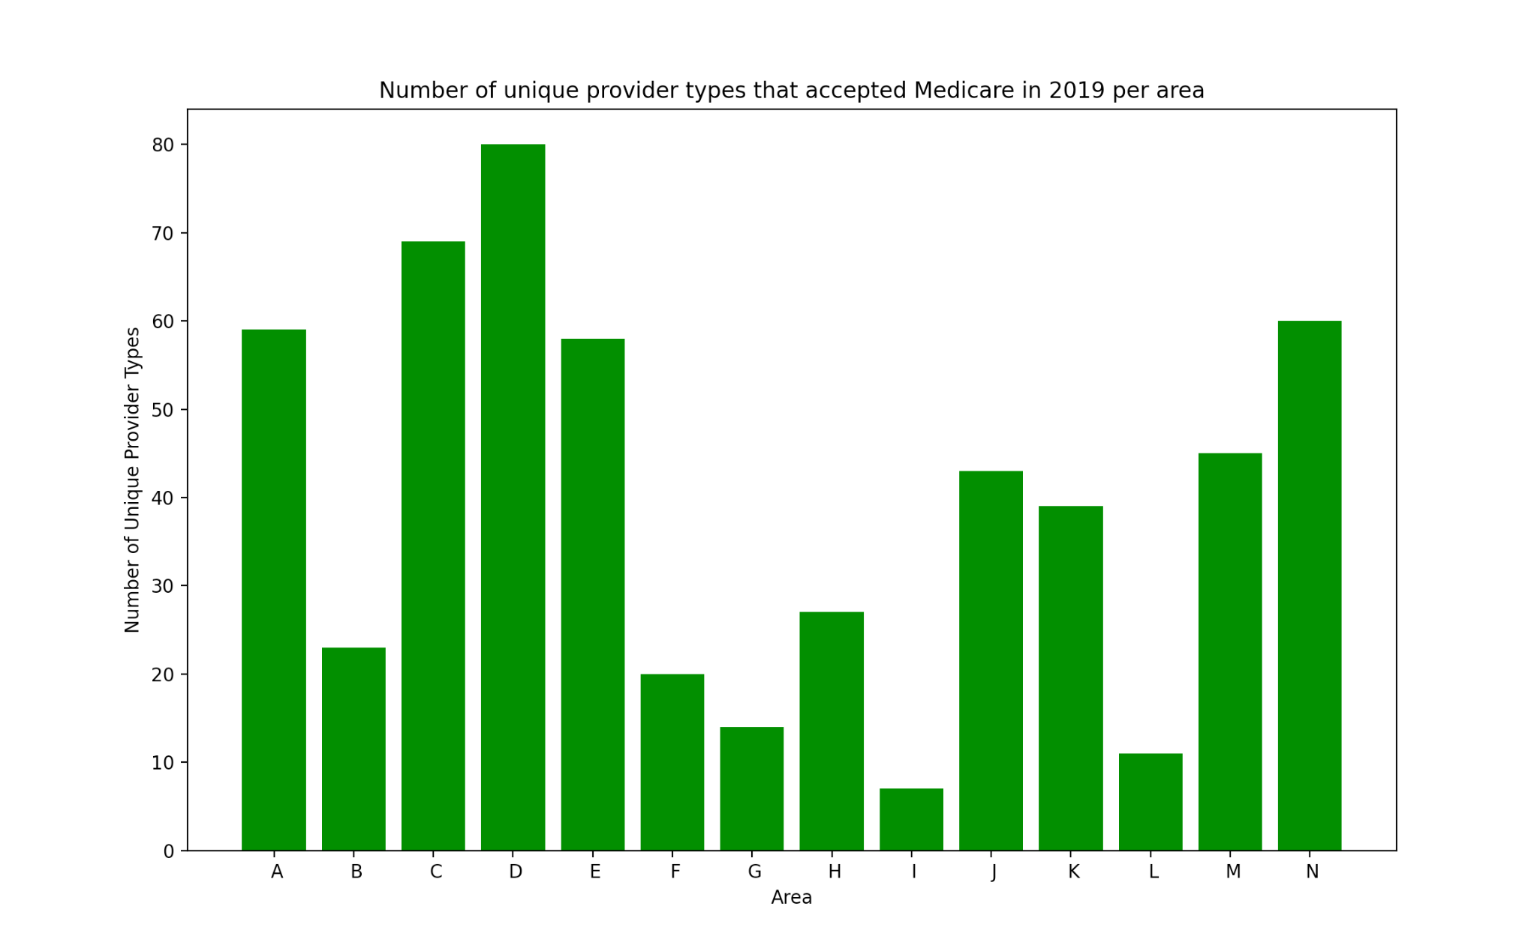
Diversity of medicare-accepted services available to populations living in different area types
Key
A: Secondary flow 30% to <50% to a larger urbanized area of 50000 and greater (59)
B: Metropolitan area low commuting: primary flow 10% to <30% to a urbanized area of 50000 and greater (23)
C: Micropolitan area core: primary flow within an urban cluster of 10000 to 49999 (69)
D: Metropolitan area core: primary flow within an urbanized area of 50000 and greater (80)
E: Metropolitan area high commuting: primary flow 30% or more to a urbanized area of 50000 and greater (58)
F: Small town high commuting: primary flow 30% or more to a urban cluster of 2500 to 9999 (20)
G: Small town low commuting: primary flow 10% to <30% to a urban cluster of 2500 to 9999 (14)
H: Secondary flow 30% to <50% to a urban cluster of 10000 to 49999 (27)
I: Secondary flow 30% to <50% to a urban cluster of 2500 to 9999 (7)
J: Secondary flow 30% to <50% to a urbanized area of 50000 and greater (43)
K: Micropolitan high commuting: primary flow 30% or more to a urban cluster of 10000 to 49999 (39)
L: Micropolitan low commuting: primary flow 10% to <30% to a urban cluster of 10000 to 49999 (11)
M: Rural areas: primary flow to a tract outside a urbanized area of 50000 and greater or UC (45)
N: Small town core: primary flow within an urban cluster of 2500 to 9999 (60)

Slide 3
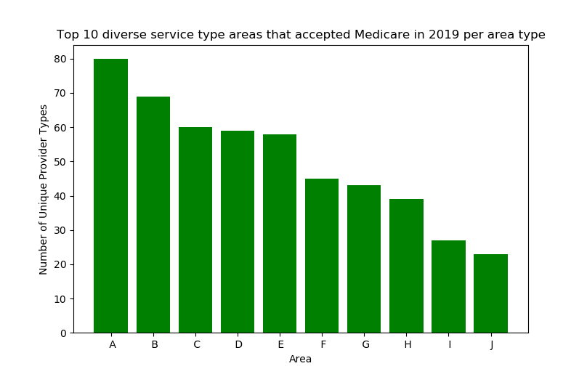
Top three area types with most diverse services
Key
A: Metropolitan area core: primary flow within an urbanized area of 50000 and greater (80)
B: Micropolitan area core: primary flow within an urban cluster of 10000 to 49999 (69)
C: Small town core: primary flow within an urban cluster of 2500 to 9999 (60)
D: Secondary flow 30% to <50% to a larger urbanized area of 50000 and greater (59)
E: Metropolitan area high commuting: primary flow 30% or more to a urbanized area of 50,000 and greater (58)
F: Rural areas: primary flow to a tract outside a urbanized area of 50000 and greater or UC (45)
G: Secondary flow 30% to <50% to a urbanized area of 50000 and greater (43)
H: Micropolitan high commuting: primary flow 30% or more to a urban cluster of 10000 to 49999 (39)
I: Secondary flow 30% to <50% to a urban cluster of 10000 to 49999 (27)
J: Metropolitan area low commuting: primary flow 10% to <30% to a urbanized area of 50000 and greater (23)

Slide 4
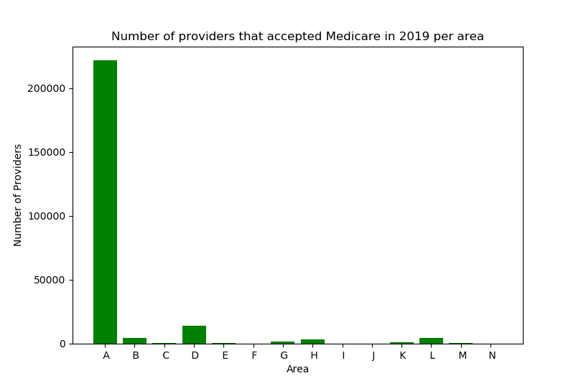
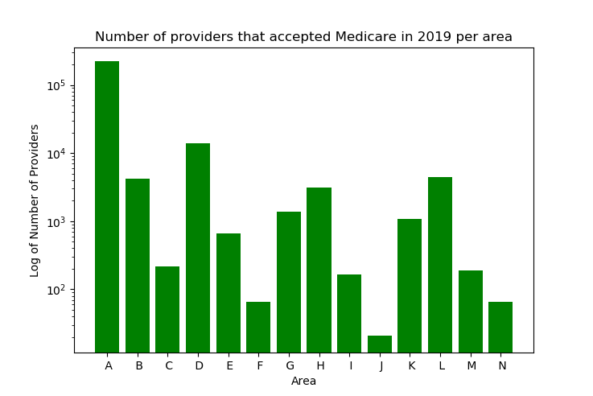
Quantity of medicare-accepted services available to populations living in different area types
Key
A: Metropolitan area core: primary flow within an urbanized area of 50000 and greater (221750)
B: Metropolitan area high commuting: primary flow 30% or more to a urbanized area of 50000 and greater (4241)
C: Metropolitan area low commuting: primary flow 10% to <30% to a urbanized area of 50000 and greater (215)
D: Micropolitan area core: primary flow within an urban cluster of 10000 to 49999 (13786)
E: Micropolitan high commuting: primary flow 30% or more to a urban cluster of 10000 to 49999 (658)
F: Micropolitan low commuting: primary flow 10% to <30% to a urban cluster of 10000 to 49999 (65)
G: Rural areas: primary flow to a tract outside a urbanized area of 50000 and greater or UC (1389)
H: Secondary flow 30% to <50% to a larger urbanized area of 50000 and greater (3131)
I: Secondary flow 30% to <50% to a urban cluster of 10000 to 49999 (164)
J: Secondary flow 30% to <50% to a urban cluster of 2500 to 9999 (21)
K: Secondary flow 30% to <50% to a urbanized area of 50000 and greater (1075)
L: Small town core: primary flow within an urban cluster of 2500 to 9999 (4426)
M: Small town high commuting: primary flow 30% or more to a urban cluster of 2500 to 9999 (190)
N: Small town low commuting: primary flow 10% to <30% to a urban cluster of 2500 to 9999 (65)

Slide 5
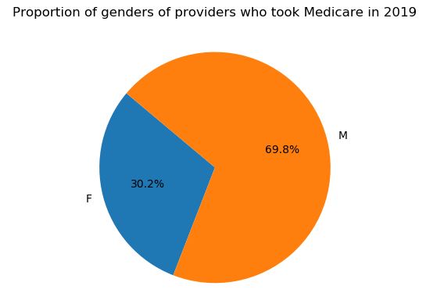
Proportion of male versus female doctors who take medicare

Slide 6
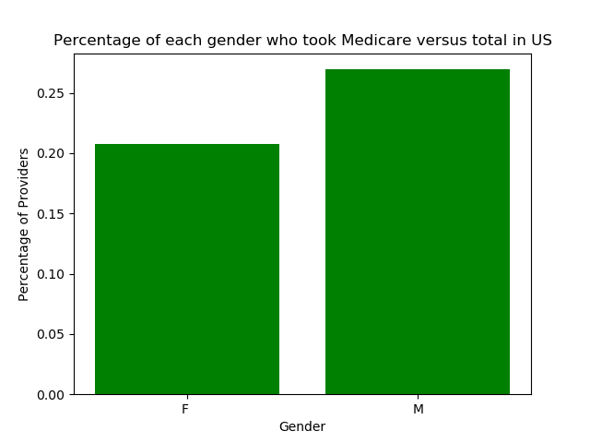
Proportion of female doctors who take medicare out of the total number of female practicing physicians versus proportion of male doctors who take medicare out of the total number of male practicing physicians

Slide 7
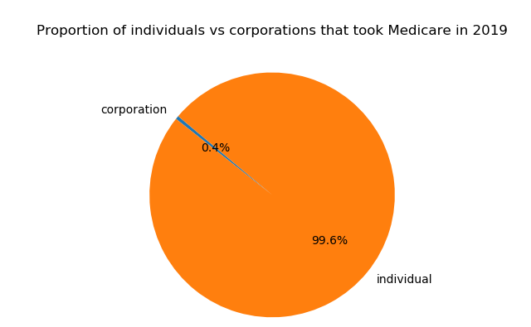
Proportion of individuals versus corporations who take medicare

Slide 8
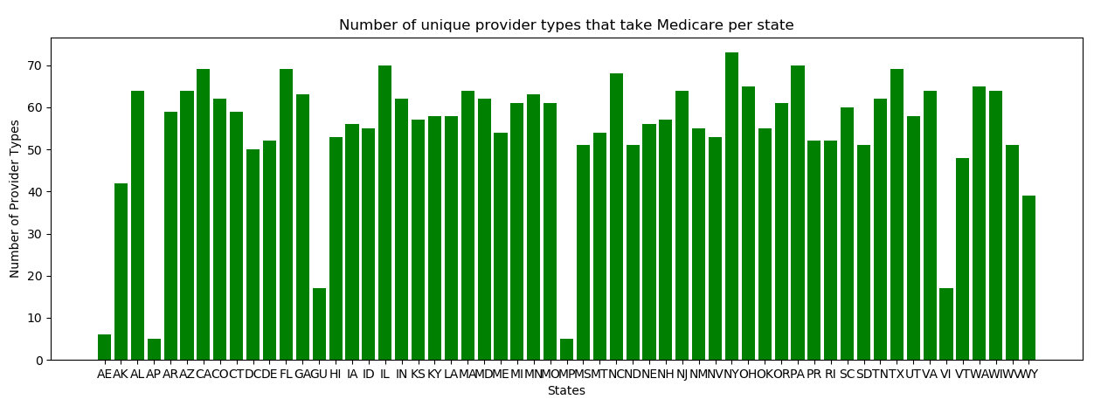
Diversity of medicare-accepted services available in each state

Slide 9
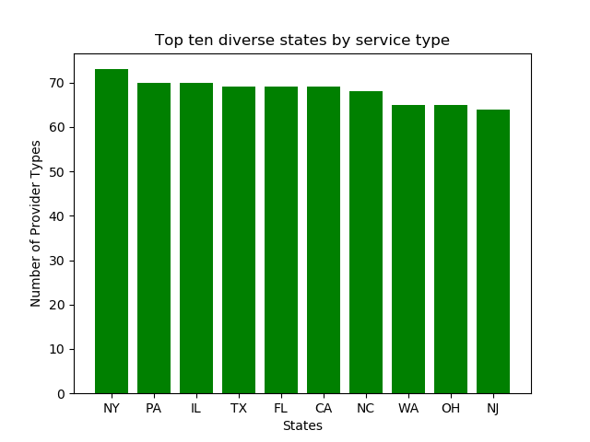
Top 10 most diverse states for medicare-accepted services

Slide 10
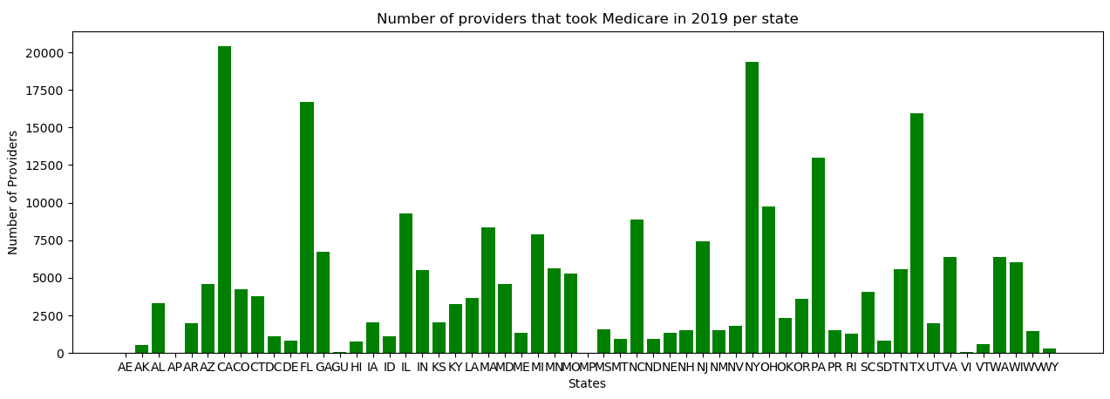
Quantity of medicare-accepted services available in each state

